Slide 1



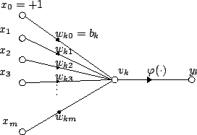
AASD4011: Mathematical Concepts for Deep Learning
Matrix Multiplication
The ‘Magic’ of
In
and its importance for neural networks

Slide 2
Conventions (in 2D)

Slide 3
Terminology
Data Instance – a single ‘real world’ example for which the model will need to provide inference on. Examples are: a tweet for sentiment analysis, an image for classification
Data Entry – a descriptor of the data instance. Together, the entries are the input the model receives per instance, on which the model is required to provide inference. For example: a character in a tweet, or the intensity of the red-color for one pixel of an RGB image.
Batch – a collection of data instances. Usually training is done in batches. In each iteration, the gradient is averaged over all data instances (average can be weighted). A batch is composed of a collection of data instances.

Slide 4
Conventions (1D and 2D)
?
10
?
20
?
30
?

Slide 5
Conventions (1D and 2D)
?
10
2
11
?
23
20
?
30
?

Slide 6
Conventions (in 2D)
?
10
3
?
20
13
29
?
30
?

Slide 7
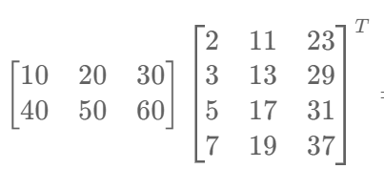
Conventions (in 2D)
X
W
Neurons
Instances
Features
Weight per Feature
X => A , neurons X activations

Slide 8
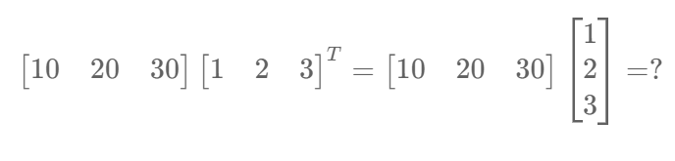
Multiple Entries, Single Instance and a Single Neuron
X
W
What are the shapes of the matrices?
What is the result?

Slide 9
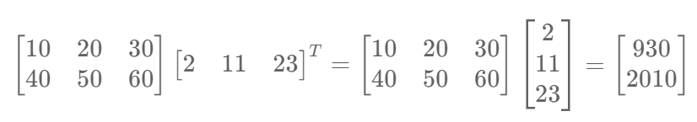
Multiple Instances and a Single Neuron
X
W
What are the shapes?

Slide 10
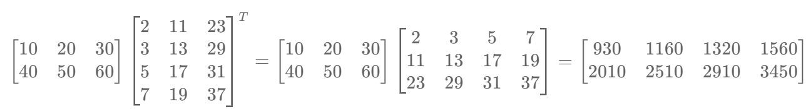
Multiple Instances and a Multiple Neurons
X
W
What are the shapes?
What does each dimension in the result represent?

Slide 11
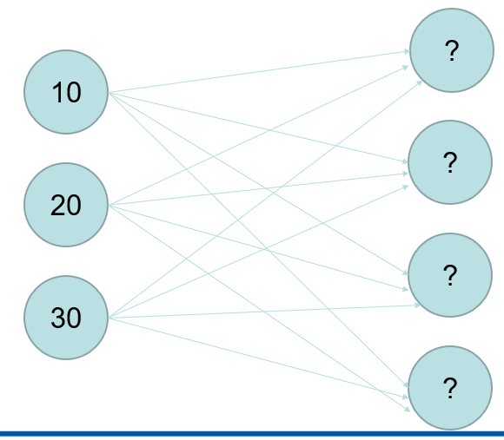
Multiple Instances and a Multiple Neurons
Instances
Activation per Neuron

Slide 12
Matrix Multiplication and GPUs
https://github.com/MaxKotlan/Cuda-Matrix-Multiplication-Benchmark

